Slide 1

NEW PARENTS MEETING
WELCOME TO RECEPTION!
2024-2025

Slide 2
Welcome!
Welcome from the Head of School or Executive Head Teacher.
Introduce Class Teacher and Teaching Assistant.
What the day looks like.
Transitions.
School dinners.
Read, write, inc.
Friends of the school.
Trips, panto.

Slide 3
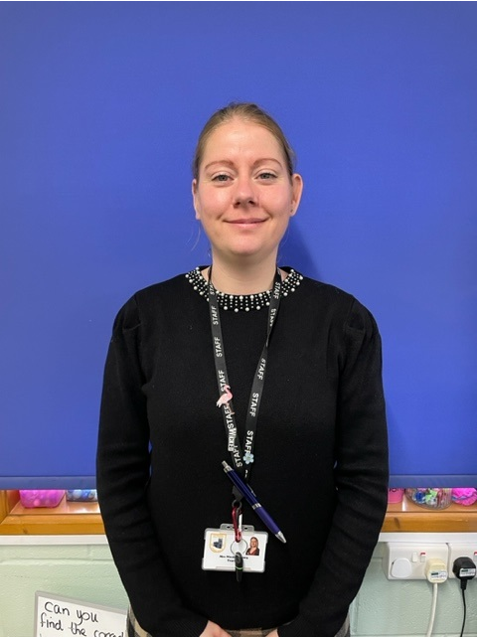
Meet the team
Mrs Brown

Slide 4
Parents as partners
We recognise the importance of parents and carers in a child’s development. You are your child’s first educators and we greatly value any input, opinions and information you can share with us about your child’s learning and progress.
We provide many opportunities for parents and carers to take an active part in their child’s education. These include:
Children’s book look once a term where you can see all the wonderful learning that has taken place that term.
Reading café, where you can share stories with your child and listen to them read.
Regular newsletters.
School Website
School Twitter page where you can see what we have been up to and post your comments.
Class dojo to communicate anything related to the learning, correspondents that we may not get to discuss in the mornings/ after school and Wow moments from your child’s education. You can also post pictures and comments about things outside of school.
Parents evening twice a year.

Slide 5
In Reception our children follow the Early Years Foundation Stage Framework (EYFS). This curriculum is based upon four themes and principles in ‘Development Matters’ The Unique Child - Positive Relationships - Enabling Environments - Learning and Development
The curriculum is broken down into 7 areas of learning. The prime areas include;
Communication and language
Personal, social and emotional development
Physical Development.
The specific areas include;
Literacy
Maths
Understanding the world
Expressive arts and design
Throughout the year we plan and deliver an engaging curriculum that supports your child’s development in all these areas. At the end of the year, we assess against the Early Learning Goals.
The EYFS Curriculum

Slide 6
Getting ready to learn
Speaking and listening
Taking turns to talk
Listening for short periods.
Holding a conversation.
These habits will help children to build up relationships, negotiate resources, extend play.
Behaviour
Boundaries/following rules
Consistent routines – particularly when it comes to sleeping/bedtime
Manners (please and thank you)
We need your support to reinforce rules at home. We are also here to support you too. Please talk to us

Slide 7
Being independent- Here are some of the key skills we would hope your child is on the way to being able to do before starting school;
Dress and undress themselves (within reason)
Use the toilet independently and ask to go there
Tidy up after himself/herself  Recognise their own name (Please tell us if their name is abbreviated in any way)
Share toys and equipment  Handle a pencil  Sing some nursery rhymes
Practise counting to 10
Listen well and follow simple instructions
Being prepared for school

Slide 8
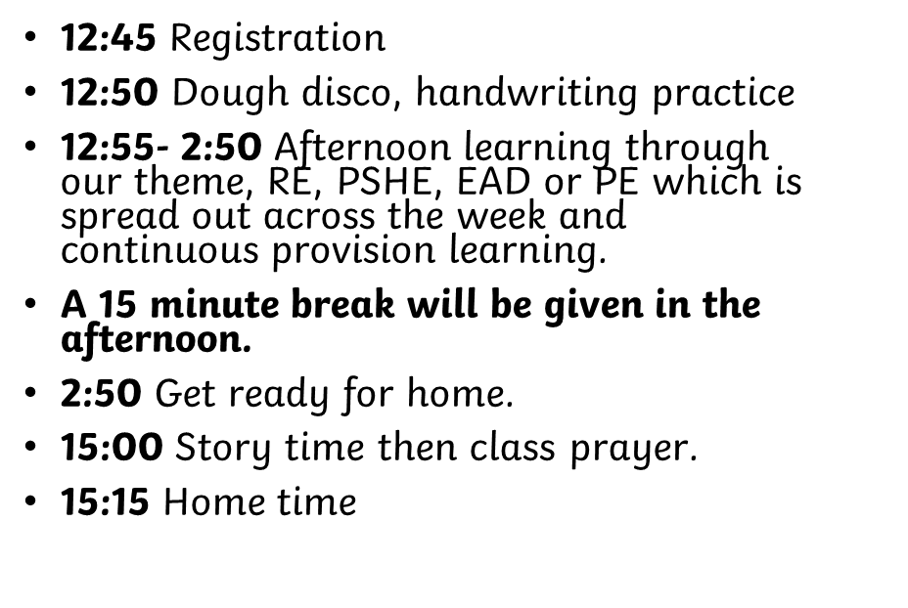
A day in our classroom
08:45 Registration
08:55 Collective worship
09:15 Maths, continuous provision
10:15 Break time
10:30 phonics,
11:15 English, continuous provision
12:00-12:45 Lunchtime.
KS1 eat second sitting.

Slide 9


Transition
Once your child gains a place in our school, I will arrange meetings with each family in your own home during the summer term prior to starting school. I will support the completion of paperwork if needed and provide information on the induction process, as well as introducing myself to your child during this meeting.
In addition to this, two visits by all children to reception class are held on afternoons near the end of the summer term prior to admission, as well as a Teddies Picnic afternoon. I will also visit the feeder nurseries to meet with key workers and children. Whilst here I will read the children stories about starting school, interact and observe the children whilst in a setting familiar setting to school.

Slide 10

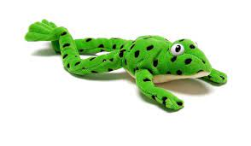
Read, Write, Inc

Slide 11

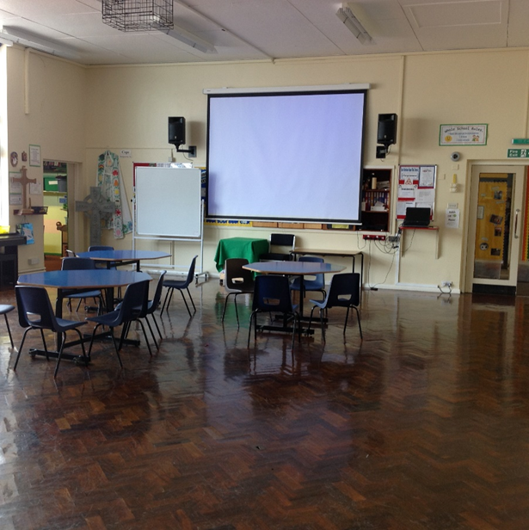
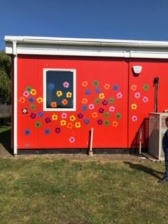
School Dinners

Slide 12
Friends of the school
All parents and carers automatically become members of friends of the school when your child starts school.
Friends of the School raises funds which go directly to provide extra resources and enhance the children’s educational experiences.
Friends of the School hold events such as Fayres, school disco and breakfast with Santa.

Slide 13
School Trips
We have been fortunate enough to go on a school trip to Tattershall farm park to visit Santa and see all the gorgeous animals they have.
The children really enjoy this experience and it is one that we plan to continue to do in the future.
The Friends of the school are also funding a whole school trip to the panto this year at Blackfriars in Boston. We are very excited about this.

Slide 14
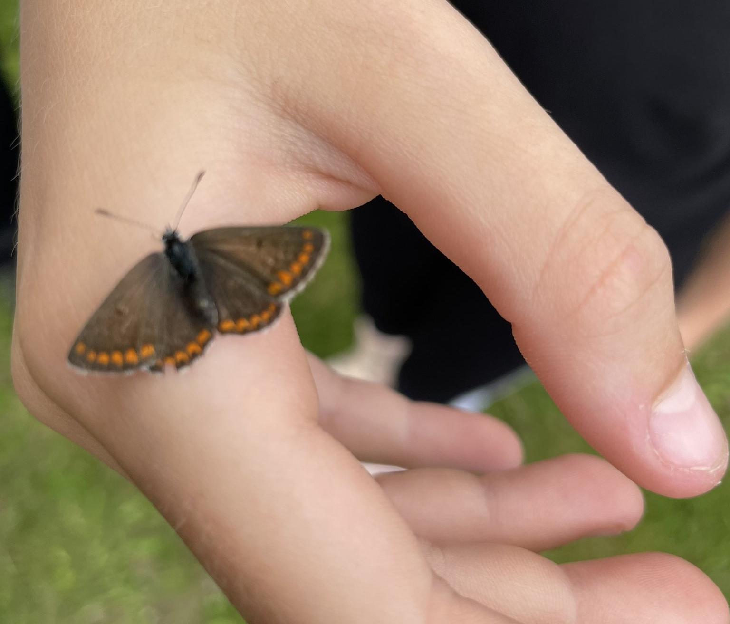
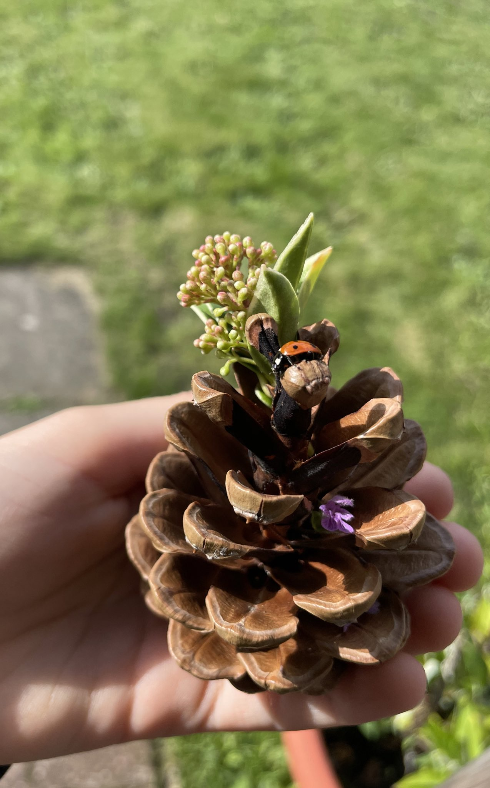
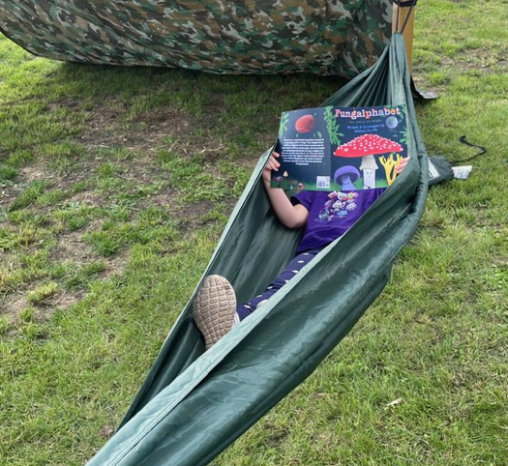
Forest school
It is an ethos that promotes self-esteem, creativity, confidence and independence. It is a series of long-term sessions that build on the needs and development of the child. It is not one-off days in the woods. It enables supported risk-taking, child-centred learning, exploration and play.

Slide 15
Thank you!

